Slide 1
Agenda 10
AGAR & Year End Financial Statements
Presented by Jodie Smart, Finance Officer/Deputy RFO

Slide 2
Annual Governance & Accountability Return
Commonly referred to by the acronym AGAR.
This is a statutory provision of Section 6 of the Local Audit and Accountability Act 2014
Haydon Wick Parish Council is classified as a smaller authority (where the higher of gross income or gross expenditure was over £25,000) and has to complete Part 3 of the Annual Governance and Accountability Return (AGAR).
As Haydon Wick Parish Council has an income and expenditure exceeding £200k it is subject to an intermediate level review. This means that it must submit prescribed documents to support the AGAR forms.
The AGAR gives the opportunity for electors and local taxpayers to see the Council’s accounting statements and governance arrangements which is then submitted to the appointed external auditor for their approval.

Slide 3
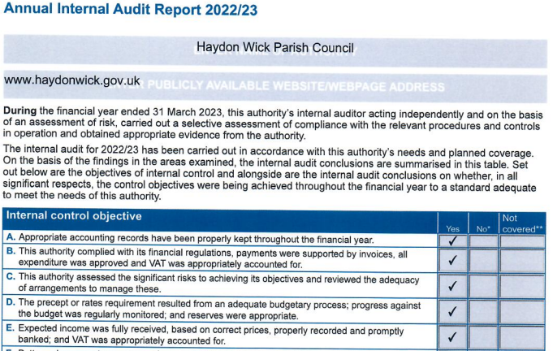
Annual Governance & Accountability Return
AGAR – Annual Internal Audit Report 2022-23
The Internal Auditor,
Darkin Miller – Chartered Accountants
has completed the internal audit for 2022/23.
She then completes this section of the AGAR….

Slide 4
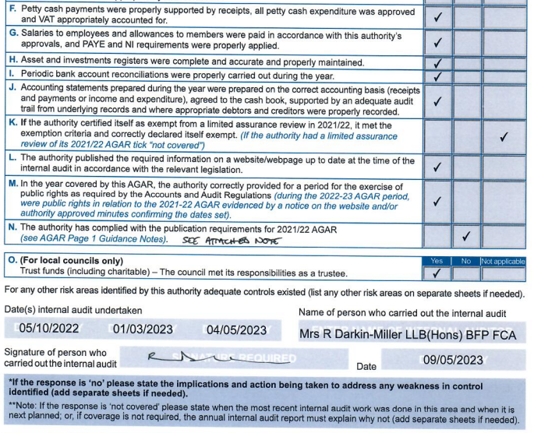
Annual Governance & Accountability Return
AGAR – Annual Internal Audit Report 2022-23
The Internal Auditor has asserted passes for all tests that are applicable except test N. This is due to the External Auditor's report and certificate being published on the Council website four days late.

Slide 5
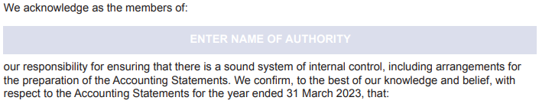
Annual Governance & Accountability Return
AGAR – Section 1, Annual Governance Statement
There are 9 statements that the Full Council must assert a ‘yes’ or ‘no’ answer to…

Slide 6
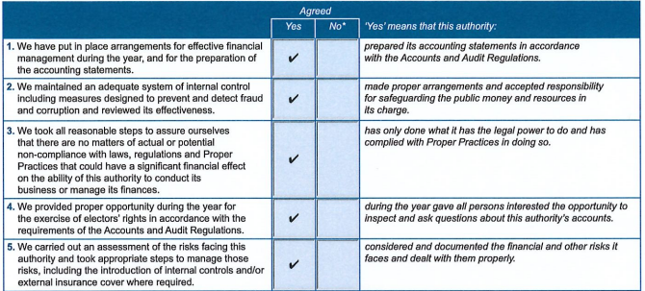
Annual Governance & Accountability Return
AGAR – Section 1, Annual Governance Statement

Slide 7
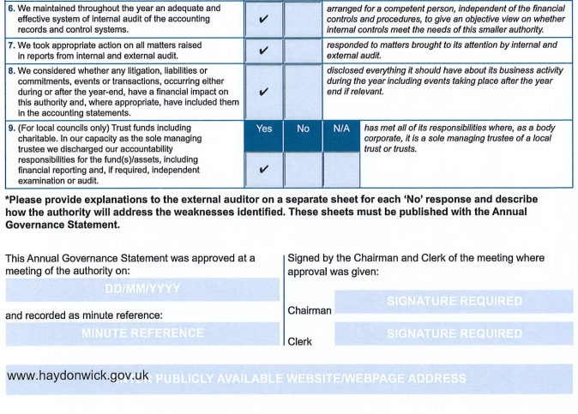
Annual Governance & Accountability Return
AGAR – Section 1, Annual Governance Statement
The Governance Statement is signed by the Chairman and
Chief Officer/Clerk & RFO

Slide 8
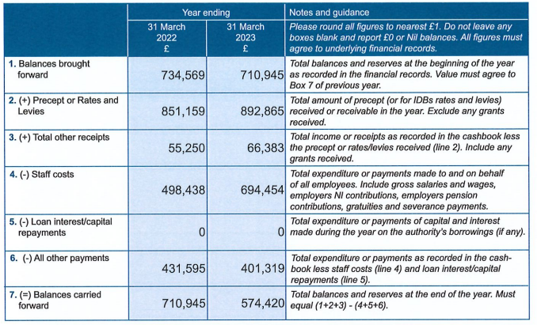
Annual Governance & Accountability Return
AGAR – Section 2, Accounting Statements
Staff salaries ONLY. Does not include Cllr Allowance or agency staff.
This figure
Precept income ONLY
All other Council expenditure
PWLB repayments will go here
Always equals this figure

Slide 9
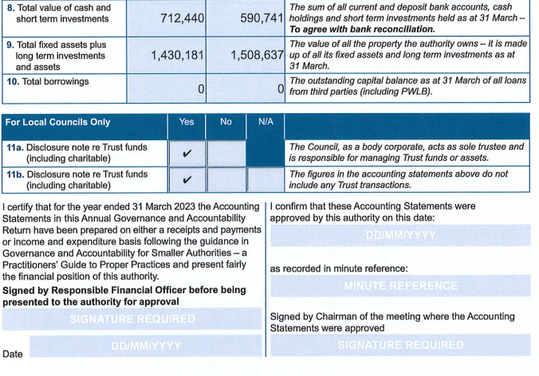
Annual Governance & Accountability Return
AGAR – Section 2, Accounting Statements
Sum of all bank balances
Balance of Asset Register
PWLB balance will go here
The accounting software codes the income and expenditure to the relevant box on the AGAR
The Accounting Statements is signed by the Chairman and the Chief Officer/Clerk & RFO

Slide 10
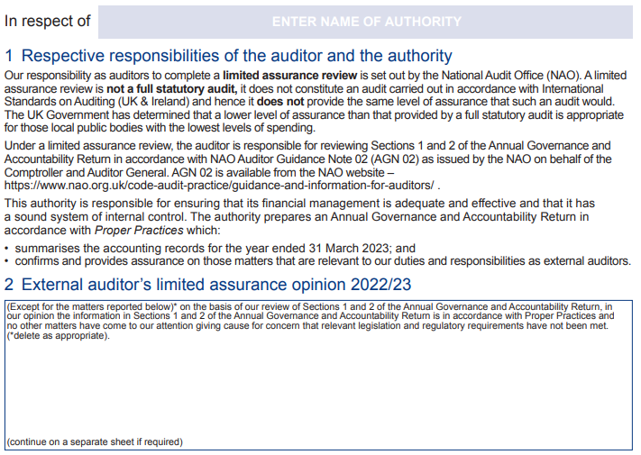
Annual Governance & Accountability Return
AGAR – Section 3, External Auditors Report & Certificate
No comments here = clean audit

Slide 11
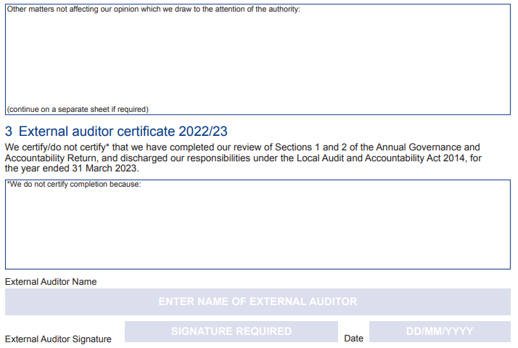
Annual Governance & Accountability Return
AGAR – Section 3, External Auditors Report & Certificate
Comments here are advisory. It is likely that there will be a note regarding the late publication of the External Auditor’s report and certificate
Comments here = Failed/qualified audit

Slide 12
Annual Governance & Accountability Return
AGAR – Supporting Documents
Total of bank balances which supports the figure in Box 8 of the Accounting Statements.

Slide 13
Annual Governance & Accountability Return
AGAR – Supporting Documents
YoY variances of £100k or 15% (whichever is lower) must be explained

Slide 14
Annual Governance & Accountability Return
AGAR – Supporting Documents
Figures to support the difference between Boxes 7 & 8.
Sales Invoices processed but not yet paid
Payments made in 22/23 relating to 23/24 expenditure
Purchase Invoices processed but not yet paid
Payments made in 23/24 relating to 22/23 expenditure

Slide 15
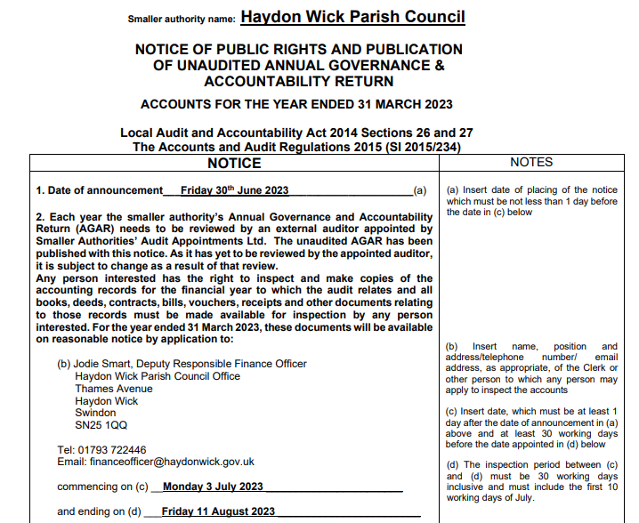
Annual Governance & Accountability Return
AGAR – Supporting Documents
To comply with Governance Statement number 4. Electors have a right to inspect the accounts during 30 working days including the first 10 days of July. This notice must be displayed from at least one day prior to the commencement date until after the period end date.

Slide 16
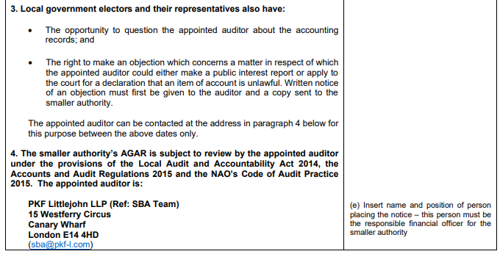
Annual Governance & Accountability Return
AGAR – Supporting Documents

Slide 17
Any Questions?

Slide 18
Agenda 11
Year End Financial Statements

Slide 19

Year End Financial Statements

Slide 20
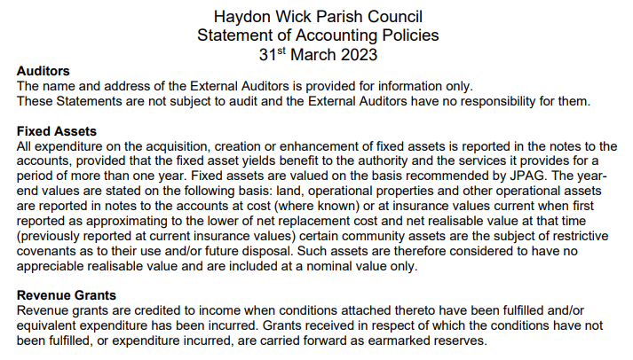
Year End Financial Statements
Statement of Accounting Policies

Slide 21
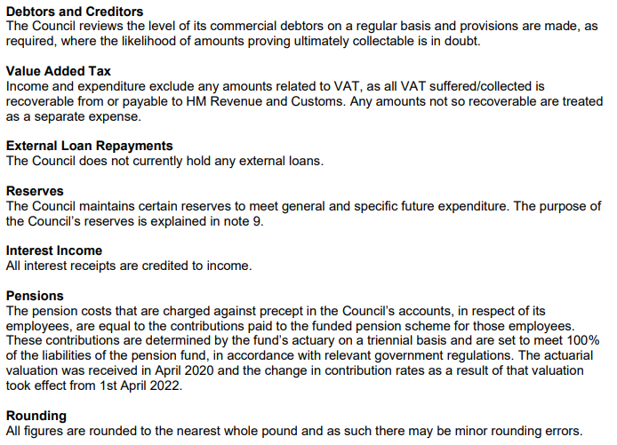
Year End Financial Statements
Statement of Accounting Policies

Slide 22
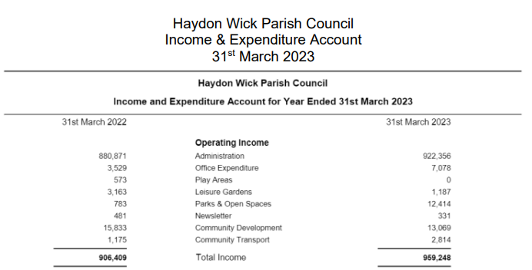
Year End Financial Statements
Income & Expenditure - Income

Slide 23
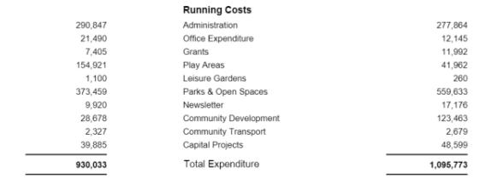
Year End Financial Statements
Income & Expenditure - Expenditure

Slide 24
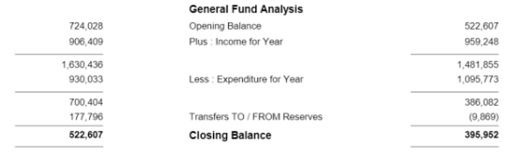
Year End Financial Statements
Income & Expenditure - Analysis
Net of movements to/from EMR’s and overspend on budgets.
General reserve at the beginning of 2023/24

Slide 25
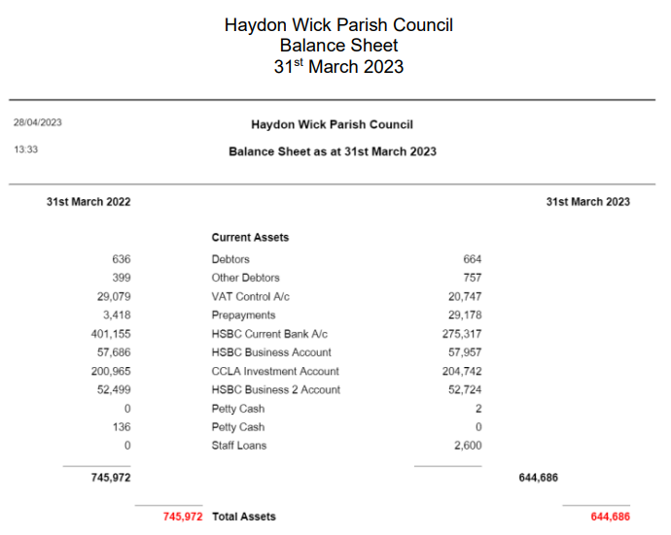
Year End Financial Statements
Balance Sheet – Current Assets
Assets = Bank balances, cash balances and monies owed to the Council.
(Pre-payments are ‘owed by FY 2023/24)

Slide 26
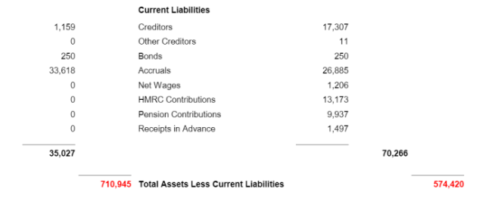
Year End Financial Statements
Balance Sheet – Current Liabilities
Liabilities = Monies owed by the Council.
(Accruals are ‘owed’ to FY 2023/24)

Slide 27
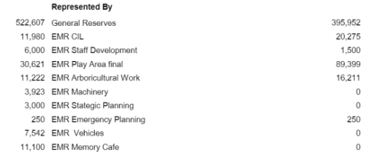
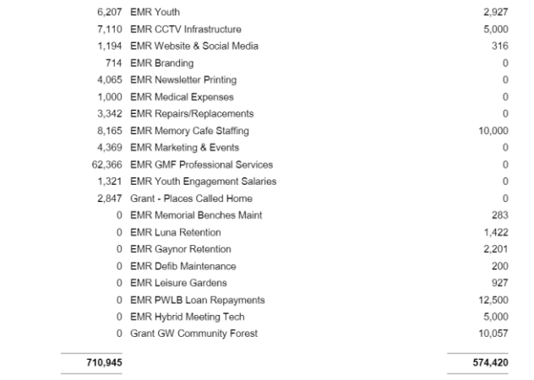
Year End Financial Statements
Balance Sheet – Represented By
General reserve + EMR balances at year end = Assets-Liabilities.

Slide 28
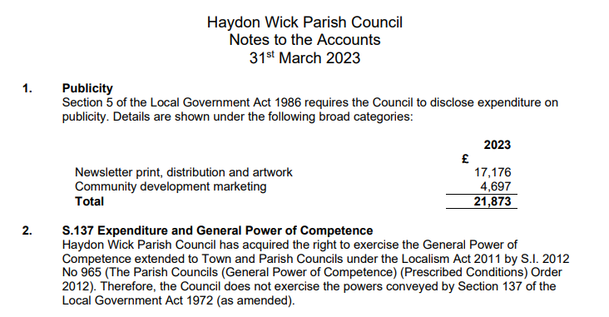
Year End Financial Statements
Notes to the Accounts

Slide 29
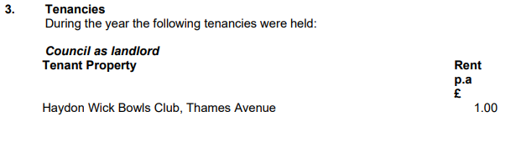
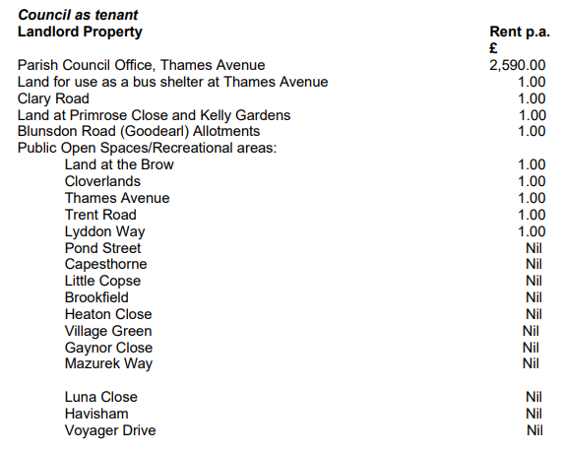

Year End Financial Statements
Notes to the Accounts

Slide 30
Year End Financial Statements
Notes to the Accounts

Slide 31
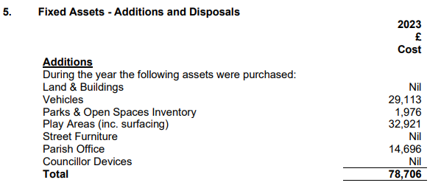
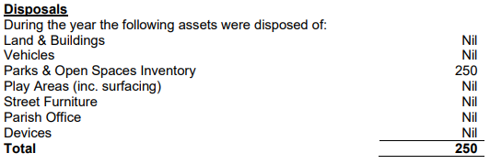
Year End Financial Statements
Notes to the Accounts

Slide 32
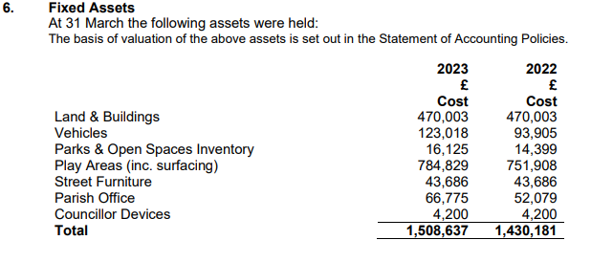
Year End Financial Statements
Notes to the Accounts

Slide 33
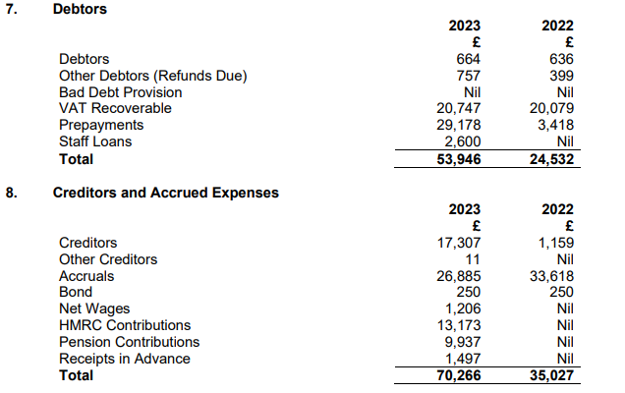
Year End Financial Statements
Notes to the Accounts

Slide 34
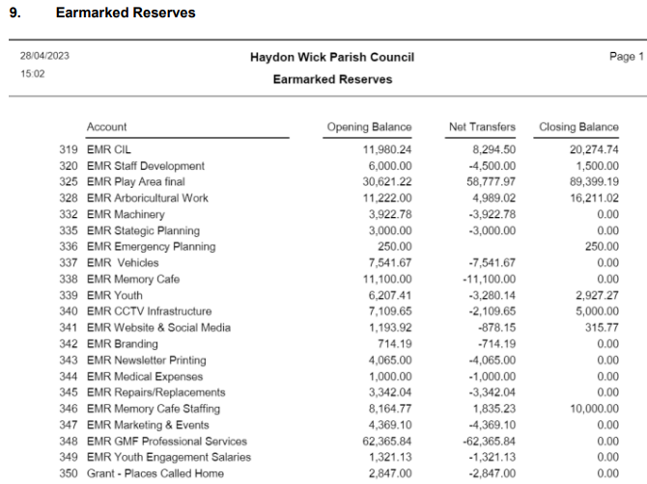
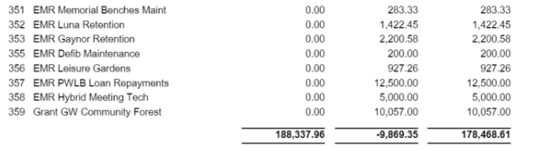
Year End Financial Statements
Notes to the Accounts

Slide 35
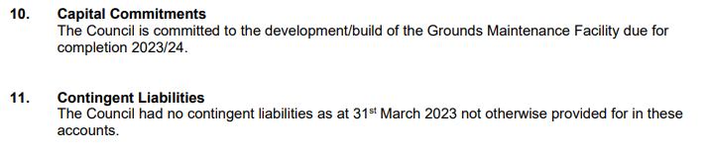
Year End Financial Statements
Notes to the Accounts
A liability that may occur depending on the outcome of an uncertain event. E.g. There are legal proceedings against the council which have not come to a conclusion at year end.

Slide 36
Any Questions?

