Slide 1
Area Board Update
Swindon Community Policing Team – July 2022
North, East and Rural​

Slide 2
Your CPT - Swindon
Swindon North, East and Rural – email; SwindonAreaCPT@wiltshire.police.uk
Inspector: Barry Reed
Neighbourhood Sergeants:
Sgt Penny Sprawson (North, North Rural)
Sgt Danny Salmon (South Rural, East)
Neigbourhood PCs
PC Keith MacDonald (North)
PC Paul Harrison (North)
PC Amanda Stevenson (North Rural)
PC Andrew Caldwell (South Rural)
PC Becky Berni (East)
PC Andy Gee (East)
PCSOs
Kate Jackson, Lee Hare, Jamie Moore, Jason Dyer, Emma Harriman (North)
Jocasta Bennett, Victoria Townsend (North Rural)
Justine Trueman, Victoria Bradley (South Rural)
Jo Cross, Charlotte Watson, Rachel Gilding, Harry Partl, (East)

Slide 3
Performance – 12 Months to June 2022
Force
Swindon CPT
Wiltshire Police recorded crime reports a YoY increase of 10.5% in the 12 months to June 2022 and continues to have one of the lowest crime rates in the country per 1,000 population.
Wiltshire Police has seen a 18.1% increase in violence without injury crimes in the 12 months to June 2022.
In June 2022, we received:
  9,427 ‘999’ calls, which we answered within 8 seconds on average;
  11,522 ‘101’ calls, which we answered within 16 seconds on average;
  12,522 CRIB calls, which we answered within 2 minutes and 27 seconds on average.
In June 2022, we also attended 1,718 emergency incidents within 9 minutes and 36 seconds on average.
Crime Type | Crime Volume | % of Crime
Totals | 16,031 | 100.0
Violence without injury | 2,947 | 18.4
Violence with injury | 2,378 | 14.8
Public order offences | 1,680 | 10.5
Criminal damage | 1,632 | 10.2
Stalking and harassment | 1,524 | 9.5
Other crime type | 5,870 | 36.6
Stop and Search information for Swindon CPT
During the 12 months leading to May 2022, 921 stop and searches were conducted in the Swindon area of which 55.5% related to a search for controlled drugs.
During 70.1% of these searches, no object was found. In 20% of cases, an object was found. Of these cases 66.0% resulted in a no further action disposal; 18.3% resulted in police action being taken; 6.8% resulted in an arrest.
Of the stop and search subjects who defined their ethnicity:
White – 682 stop and searches
Black or Black British – 67 stop and searches
Asian or Asian British – 53 stop and searches
Mixed – 49 stop and searches
Chinese or other ethnic group – 4 stop and searches
Crime Type | Crime Volume | % of Crime
Totals | 42,401 | 100.0
Violence without injury | 7,456 | 17.6
Violence with injury | 6,268 | 14.8
Criminal damage | 5,139 | 12.1
Stalking and harassment | 4,172 | 9.8
Public order offences | 4,104 | 9.7
Other crime type | 15,262 | 36.0

Slide 4
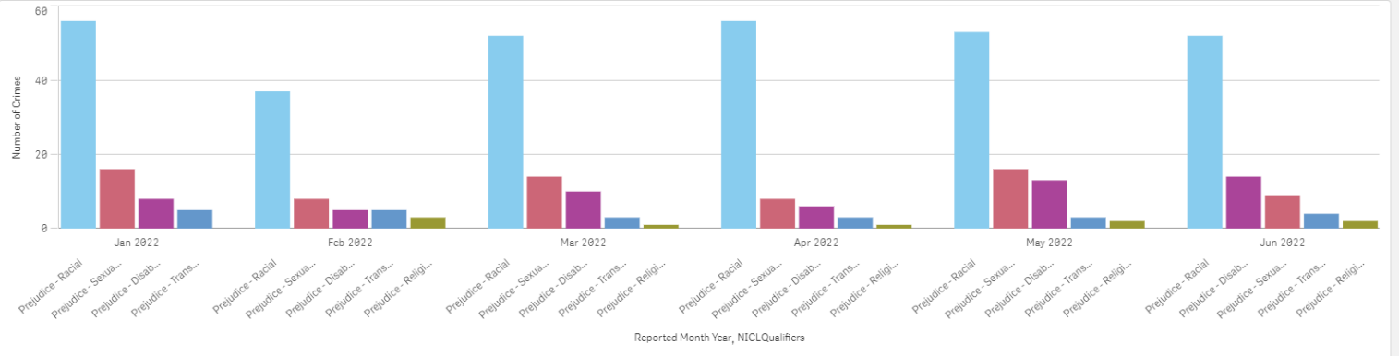
Performance – Hate Crime Overview
Force
Swindon CPT
Hate Crime is reporting as stable, with a slight loss of seasonality since the impact of Covid. Volumes are now reporting flatter across the year. Year on year reporting increases in Transgenger and Sexual Orientation related hate which follows National trends.
Work by the Hate Crime Silver Scrutiny Panel on hate crime video to raise awareness of Hate Crime and how to report it, including details surrounding how the Criminal Justice System responds to it is ongoing. There is an increased focus on Out of Court Disposal outcomes relating to Hate Crimes.
 | Number of Crimes | Change (number) | Change (%)
Total | 389 | 8 | 2.1%
Prejudice – Racial | 286 | -13 | -4.3%
Prejudice – Sexual orientation | 73 | 16 | 28.1%
Prejudice - Disability | 21 | -3 | -12.5%
Prejudice - Religion | 13 | 3 | 30.0%
Prejudice - Transgender | 12 | 7 | 140.0%
Year on year comparison June 2021 to June 2022 (note: an individual crime can be tagged with more than one prejudice type e.g. sexual orientation & transgender)
Force Hate Crime (6 months to June 2022)

Slide 5
Local Priorities & Updates
Priority | Update
North Sector | ASB in Redhouse – Youth related Crime There has been an increase in High visibility patrols to combat the seasonal rise in ASB linked to school holidays. Officers have been targeting known areas of congregation to reduce fears in community.
North Sector | Speeding/Road related matters (linked to Car meets in Orbital) Partnership working with ASDA and British Land to reduce the community impact – increased patrols. Speeding/Red light offences Thamesdown Drive – numerous enforcement (recently 4 x drivers reported for summons for excessive speed 70mph in 40mph limit)
North East Sector | Speed Enforcement and Road Safety in Highworth and surrounding Rural areas Day of action took place on 20th July with 59 Drivers stopped and 18 given TOR’s (Traffic Offence Reports – either FPN or Speed awareness courses), there was one arrest for Drug driving and one vehicle seized for no insurance.
North East Sector | ASB – Co-op/High Street area Increased High visibility patrols to combat seasonal rise in ASB linked to school holidays.

Slide 6
Local Priorities & Updates Continued
Priority | Update
East Sector | Eldene ASB/Criminality Policing activity continues in targeting a known group who cause issues in the community. This group have had intensive targeted policing for over two years with notable results (Group members have been sentenced to over 35 years of imprisonment for varying offences. CCTV has now been installed which seems to have displaced this group out of the square. Community engagement events and pop up crime surveys are scheduled for September.
South Rural | ASB – Coronation Road Targeted activity has taken place over several months for the ASB and Neighbourhood disputes in Coronation Road. Partnership working has proved positive, with a former resident having an Injunction placed upon them and a Closure Order on their address. This has reduced ASB and calls for assistance to the area considerably
South Rural | ASB – Comet Way We continue to receive sporadic reports of vehicle related ASB in Comet Way. There have been increased patrols however, no formal action has yet to be taken by the subjects.

Slide 7
Other Notable Information
The recent Traveller Incursion in Highworth was dealt with swiftly and effectively by Hayley Jenkins (SBC) and Pc Mandy Stevenson, their brilliant partnership working bringing this incident to a quick resolution to the relief of the local community.
I am pleased to announce that we will be joined in September with two further Police Officers, both who previously worked the area as PCSO’s. I am sure you will warmly welcome Pc Simon Graw (South Rural/East) and Pc Dom Tonge (North/North East) to the team.
We also say farewell this month to PCSO Emma Turner, who has left Wiltshire Police after 10 years service to start her own business – I am sure the Communities of South Rural will join her colleagues in wishing her well in her new adventure.

Slide 8
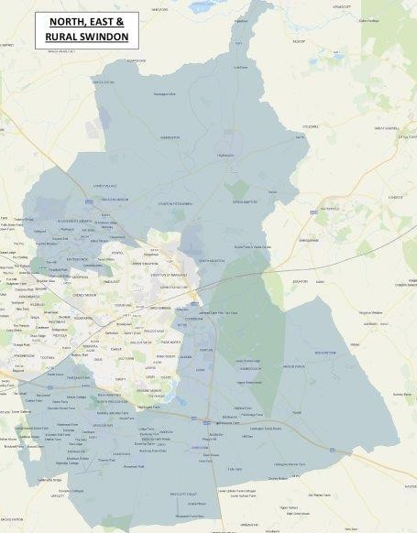
Our Sector – North, East and Rural Swindon
NER Neighbourhood Team
North – covers Haydon Wick and St Andrews Parishes
North East – covers Highworth and Thames Valley Parishes
East – covers Liden/Eldene and Nythe, and Covingham Parishes
South Rural – covers Wroughton, Chiseldon and Ridgeway Parishes

Slide 9
Useful Links
For more information on Wiltshire Police’s performance please visit:
PCC’s Website - https://www.wiltshire-pcc.gov.uk/
HMICFRS Website - https://www.justiceinspectorates.gov.uk/hmicfrs/police-forces/wiltshire/
Police.uk - https://www.police.uk/pu/your-area/wiltshire-police/
For information on what crimes and incidents have been reported in the Swindon Community Policing Team area, visit https://www.wiltshire.police.uk/police-forces/wiltshire-police/areas/about-us/about-us/cpts/swindon-cpt/ to view a crime and incident map and find links to more detailed data

Slide 10

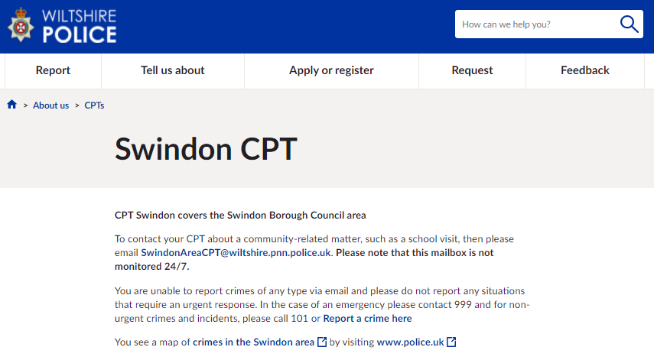
Get Involved
Keep up to date with the latest news and alerts in your area by signing up to our Community Messaging service – www.wiltsmessaging.co.uk
Follow your CPT on social media
Swindon Police Facebook
Swindon Police Twitter
Find out more information on your CPT area at: www.wiltshire.police.uk and here www.wiltshire-pcc.gov.uk

